Slide 1
Edu-Tech: E-Learning Platform
SUBMITTED BY :TEAM TERMINATORS
PARUL SEHOTRA
DALBEER SINGH
DEEPANSHI
NIKITA

Slide 2
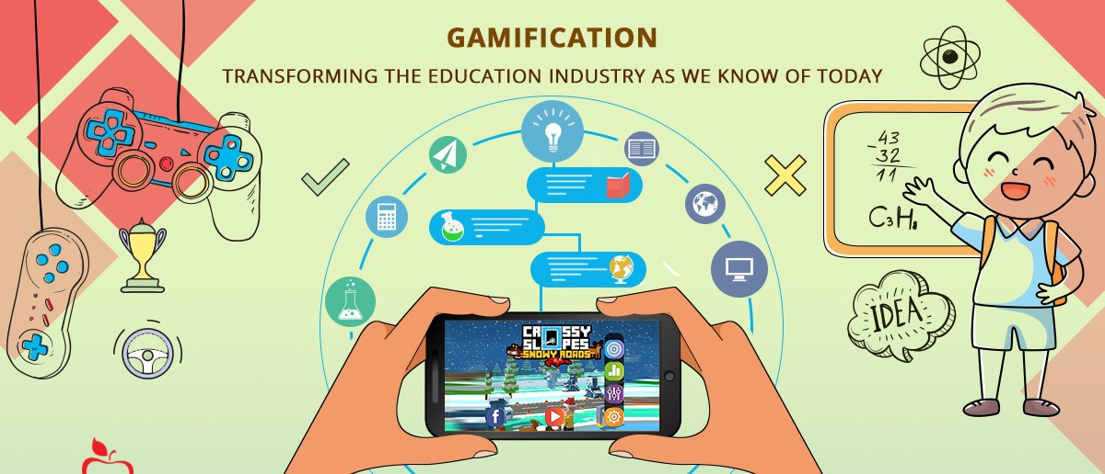
“Tell me, and I’ll forget, show me , and I may remember, Involve me, and I’ll understand”

Slide 3
RECENT TEACHING TECHNOLOGY
Education Technology is the effective use of technology tools in learning as a concept it concerns an array of tools such as media, machines and networking hardware as well as considering underlying theoretical perspective for their effective application.

Slide 4
Gamification of learning
The gamification of learning is an educational approach to motivate students to learn by using video game design and game elements in learning environments .
“Impressive in quality" and "part of a thoughtful process" can help to achieve learning goals.
In educational contexts, examples of desired student behaviour which gamification can potentially influence include attending class, focusing on meaningful learning tasks, and taking initiative.

Slide 5
IDEA BRIEF
Creating an android application with which we can can setup a point system by presenting learning content in integration with game elements in a motivating way, earning points motivates students and helps them feel rewarded for their efforts.
By implementing a progress tracker tool, from which we are able to track the progress made by each student.
We can apply Action Based Content Unlocking approach.

Slide 6
TECH STACK
Flutter.
C sharp.
Database , My SQL.
Angular.

Slide 7
How can we gamify education in my classroom?
Adapt old-school games for classroom use.
Give points or badges for meeting academic objectives.
Create challenges or quests instead of homework and assignments.
Give students voice and choice.
Embrace failure; Emphasize practice.
Make progress visible.
Allow second chances and third.
Provide instant feedback.

Slide 8
Benefits
Giving students ownership of their learning.
Opportunities for identity work through taking on alternate selves.
Freedom to fail and try again without negative repercussions.
Chances to increase fun and joy in the classroom.
Opportunities for differentiated instruction.
Providing a manageable set of subtasks and tasks.

Slide 9
Effectiveness
The research of Domínguez and colleagues about gamifying learning experiences suggests that common beliefs about the benefits obtained when using games in education can be challenged. Students who completed the gamified experience got better scores in practical assignments and in overall score, but their findings also suggest that these students performed poorly on written assignments and participated less on class activities, although their initial motivation was higher. The researchers concluded that gamification in e-learning platforms seems to have the potential to increase student motivation, but that it is not trivial to achieve that effect, as a big effort is required in the design and implementation of the experience for it to be fully motivating for participants. On the one hand, qualitative analysis of the study suggests that gamification can have a great emotional and social impact on students, as reward systems and competitive social mechanisms seem to be motivating for them. But quantitative analysis suggests that the cognitive impact of gamification on students is not very significant. Students who followed traditional exercises performed similarly in overall score than those who followed gamified exercises. Disadvantages of gamified learning were reported by 57 students who did not want to participate in the gamified experience. The most frequent reason argued by students was 'time availability'. The second most important reason were technical problems. Other reasons were that there were too many students and that they had to visit so many web pages and applications at the university that they did not want to use a new one.

Slide 10
THANKS…….

